Slide 1

Nautical Information Provision Working Group
Outcome of NCSR2 effecting NIPWG
NIPWG2, Monaco, March 2016
Presented by Mr. Jens Schröder-Fürstenberg (NIPWG Chair)

Slide 2
Item 6 (additional modules for INS PS)
Module 1
Intergrated Navigation
Display System (INS)
Performance
Standards
Module 2
Module 3
Module n
Module n+x
harmonization of bridge design and display of information

Slide 3
Item 9 and 13 (interconnection and display of NAVTEX and SafetyNET on INS)
NAVTEX
Intergrated Navigation
Display System (INS)
Display
Harmonised interface
Inmarsat
SafetyNET

Slide 4
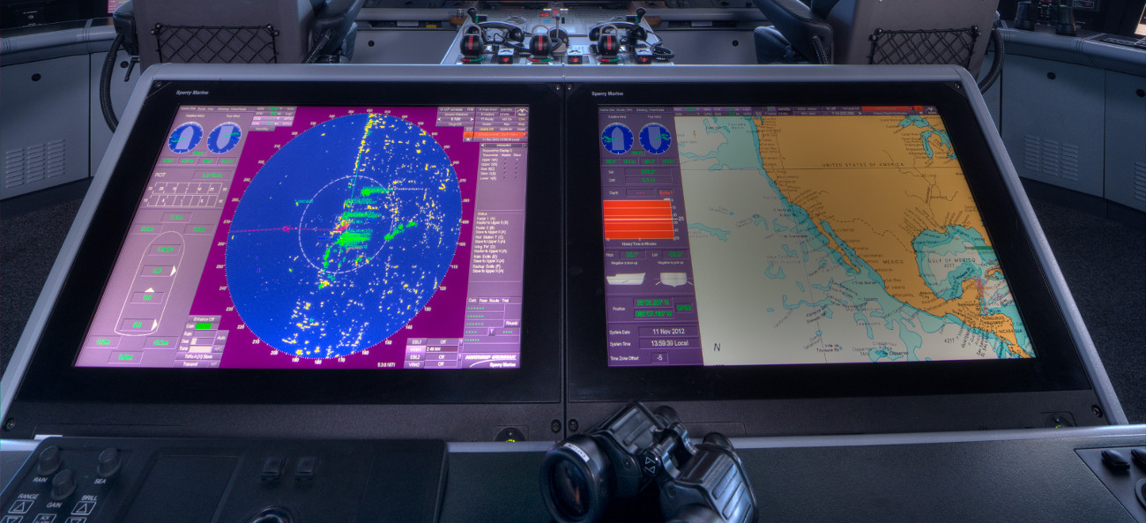
Item 28 (Develop Guidance on S-Mode of navigational equipment)
http://www.sperrymarine.com/sites/default/files/carousel-slides/VisionMaster_ECDIS_v3.jpg
Notes:
The real joke is that they promote an ECDIS and the chart on the right display is a raster image.

Slide 5
NIPWG involvement
Item | Leader | Expected outpt | NIPWG rep
6 | China | additional modules for INS PS
9 | Norway | Harmonised display of MSI
13 | U.S. | Revision of several PS to implement the harmonised display of NAVTEX and SafeyNET messages
28 | tdb | Guidance on S-Mode of navigational equipement
Further IMO proposals :
NIPWG members who participate in S-Mode should also consider participation in INS PS

